Slide 1
Sets

Slide 2
In mathematics, a set is a collection of distinct objects, considered as an object in its own right. For example, the numbers 2, 4, and 6 are distinct objects when considered separately, but when they are considered collectively they form a single set of size three, written {2,4,6}.

Slide 3
Sets are one of the most fundamental concepts in mathematics. Developed at the end of the 19th century, set theory is now a ubiquitous part of mathematics, and can be used as a foundation from which nearly all of mathematics can be derived. In mathematics education, elementary topics such as Venn diagrams are taught at a young age, while more advanced concepts are taught as part of a university degree.

Slide 4
The German word Menge, rendered as "set" in English, was coined by Bernard Bolzano in his work The Paradoxes of the Infinite.

Slide 5
Set theory is the branch of mathematical logic that studies sets, which are collections of objects. Although any type of object can be collected into a set, set theory is applied most often to objects that are relevant to mathematics. The language of set theory can be used in the definitions of nearly all mathematical objects.

Slide 6
The modern study of set theory was initiated by Georg Cantor and Richard Dedekind in the 1870s. After the discovery of paradoxes in naive set theory, numerous axiom systems were proposed in the early twentieth century, of which the Zermelo–Fraenkel axioms, with the axiom of choice, are the best-known.

Slide 7
Set theory is commonly employed as a foundational system for mathematics, particularly in the form of Zermelo–Fraenkel set theory with the axiom of choice. Beyond its foundational role, set theory is a branch of mathematics in its own right, with an active research community. Contemporary research into set theory includes a diverse collection of topics, ranging from the structure of the real number line to the study of the consistency of large cardinals.

Slide 8
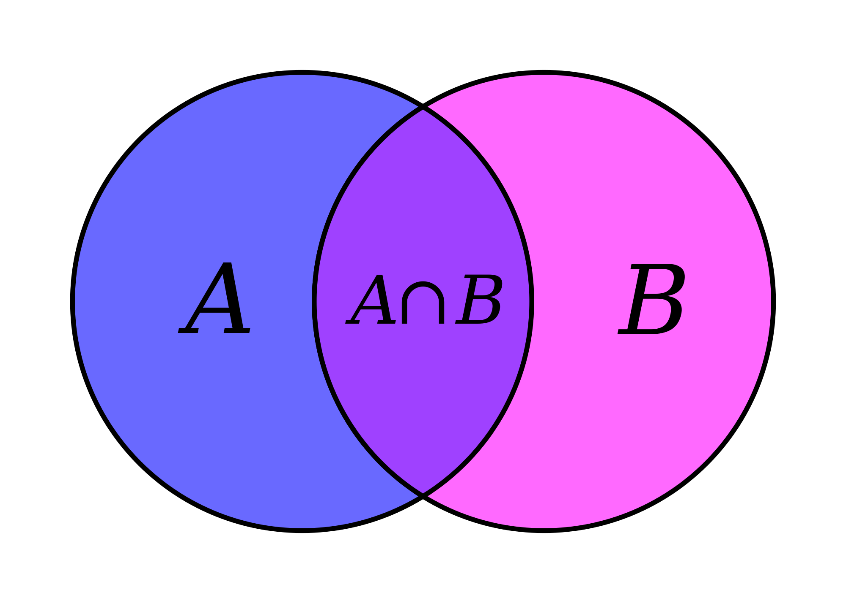

Slide 9
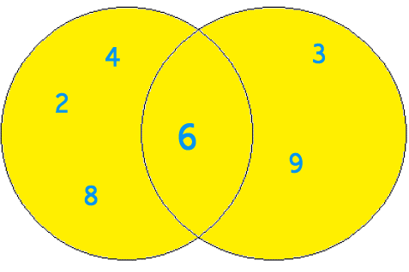

Slide 10
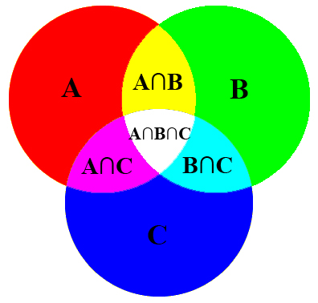

Slide 11
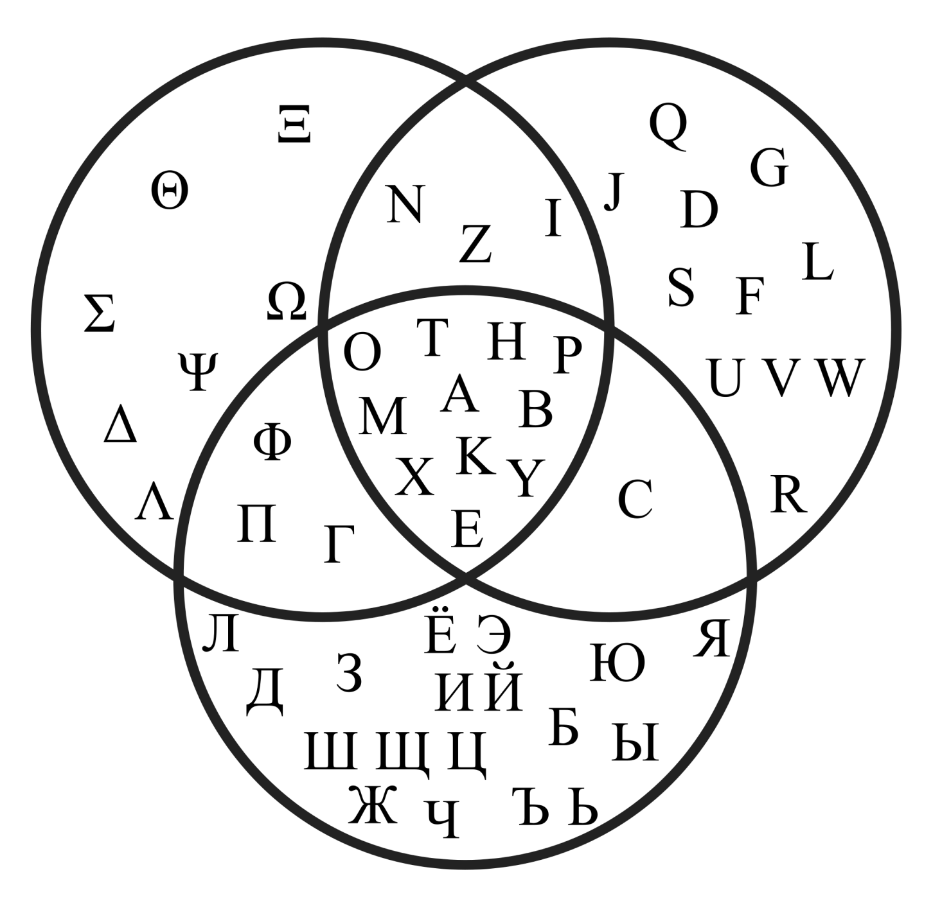

Slide 12
Fuzzy sets

Slide 13
In mathematics, fuzzy sets are sets whose elements have degrees of membership. Fuzzy sets were introduced by Lotfi A. Zadeh and Dieter Klaua in 1965 as an extension of the classical notion of set. At the same time, Salii (1965) defined a more general kind of structures called L-relations, which he studied in an abstract algebraic context. Fuzzy relations, which are used now in different areas, such as linguistics (De Cock, et al., 2000), decision-making (Kuzmin, 1982) and clustering (Bezdek, 1978), are special cases of L-relations when L is the unit interval [0, 1].

Slide 14
In classical set theory, the membership of elements in a set is assessed in binary terms according to a bivalent condition — an element either belongs or does not belong to the set. By contrast, fuzzy set theory permits the gradual assessment of the membership of elements in a set; this is described with the aid of a membership function valued in the real unit interval [0, 1]. Fuzzy sets generalize classical sets, since the indicator functions of classical sets are special cases of the membership functions of fuzzy sets, if the latter only take values 0 or 1.

Slide 15
In fuzzy set theory, classical bivalent sets are usually called crisp sets. The fuzzy set theory can be used in a wide range of domains in which information is incomplete or imprecise, such as bioinformatics.
It has been suggested by Thayer Watkins that Zadeh's ethnicity is an example of a fuzzy set because "His father was Turkish-Iranian (Azerbaijani) and his mother was Russian. His father was a journalist working in Baku, Azerbaijan in the Soviet Union...Lotfi was born in Baku in 1921 and lived there until his family moved to Tehran in 1931."

